Slide 1


Slide 2
Overview
Rockbuster Stealth LLC is a movie rental company that used to have stores around the world.
In response to intense competition from streaming giants like Netflix and Amazon Prime, the Rockbuster Stealth management team is strategizing to leverage its current movie licenses by introducing an online video rental service, aiming to maintain competitiveness.

Slide 3
Key Objectives
Which movies contributed to the most/least to revenue gain?
What was the average rental duration for all videos?
Which countries are Rockbuster customers based in?
Where are customers with high lifetime value based?
Do sales figure vary among geographic regions?

Slide 4
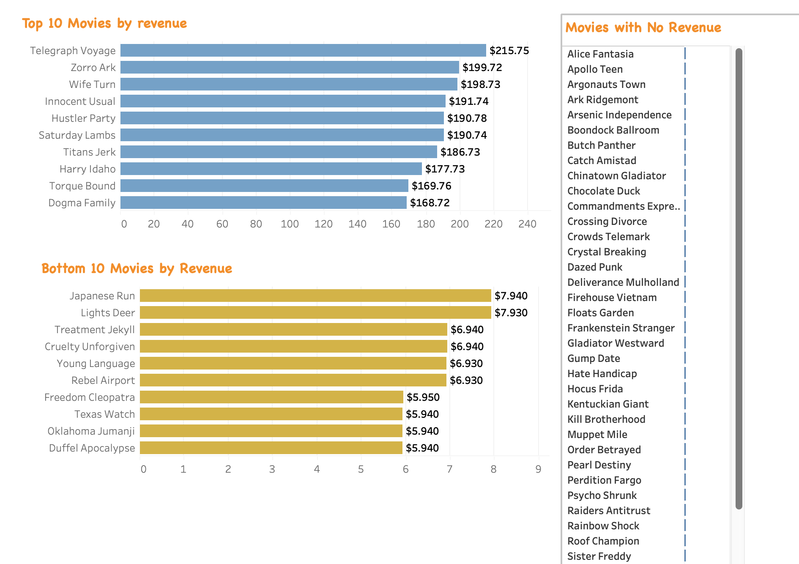
WHICH MOVIES CONTRIBUTED TO THE MOST/LEAST TO REVENUE GAIN?

Slide 5
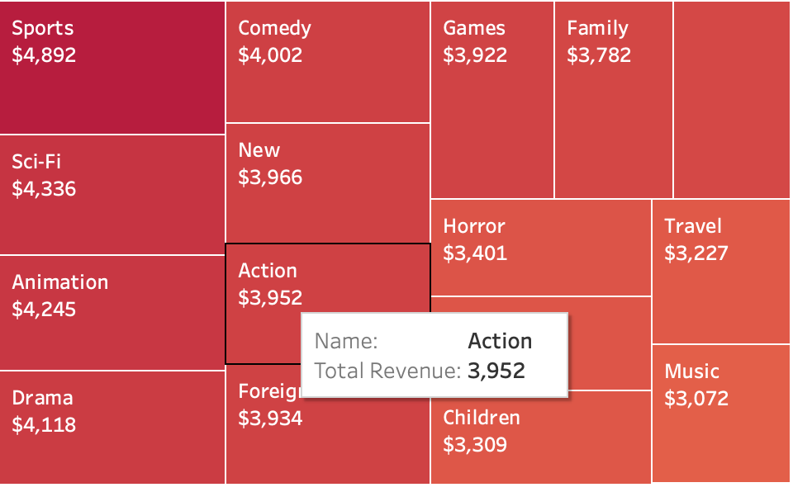
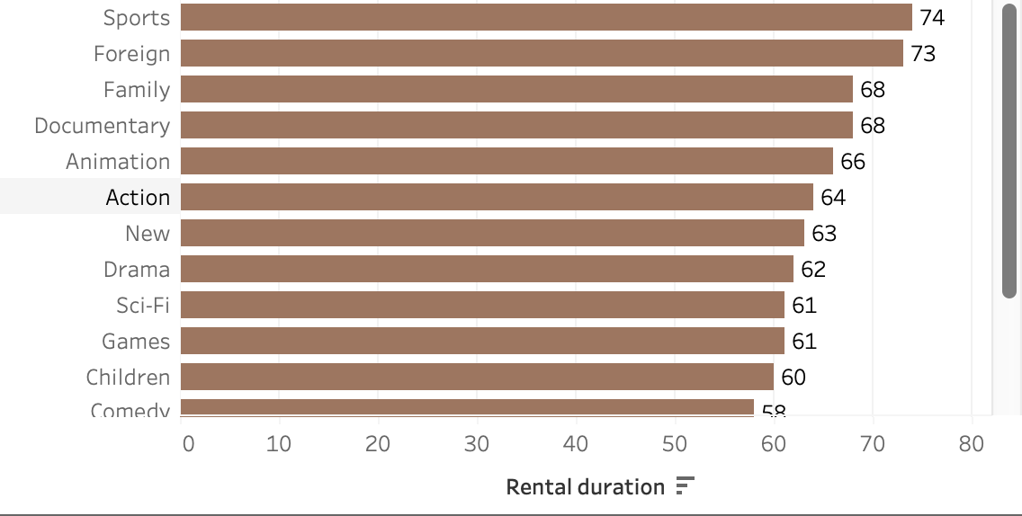
Revenue Analysis by category
The Sports Genre films fetches highest revenue. So, Sports films have the contributes to the most amount of inventory.
Children and Comedy films make the most of the revunue but, they lack in making inventory.
Sports & Foreign Genre films has high rental durations. Thus, contributing to high revenue.

Slide 6
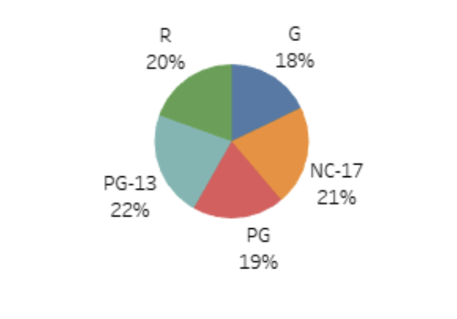
Analysis by rating
Pie chart shows that all the films rating offer a similar amount of revenue with a small difference.
PG-13 rated films generated the most amount of revenue and G rated films generated the least amount of revenue.

Slide 7
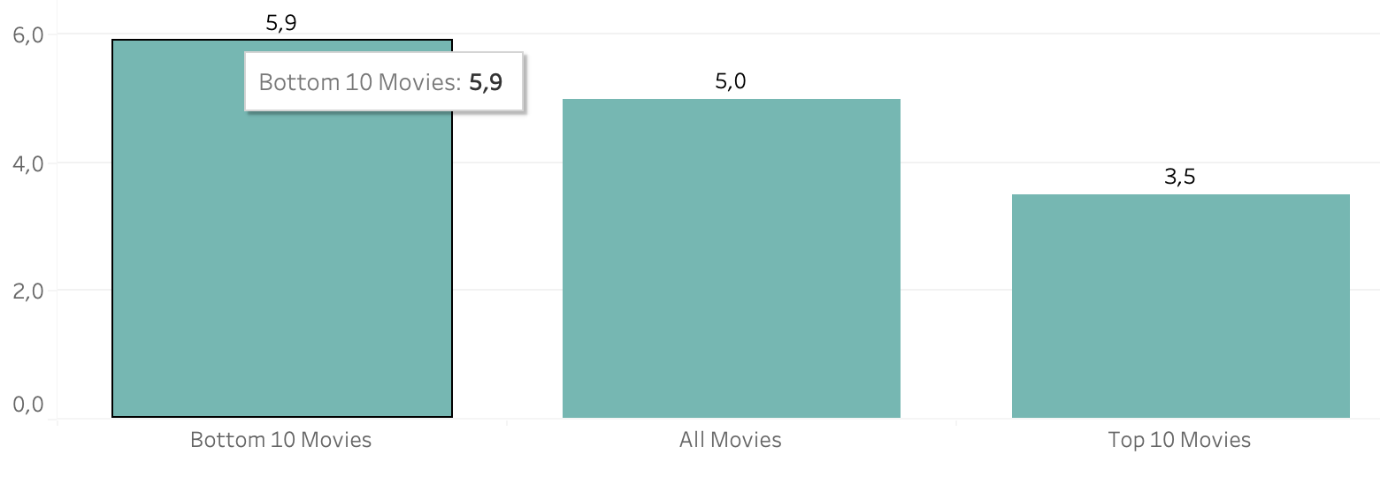
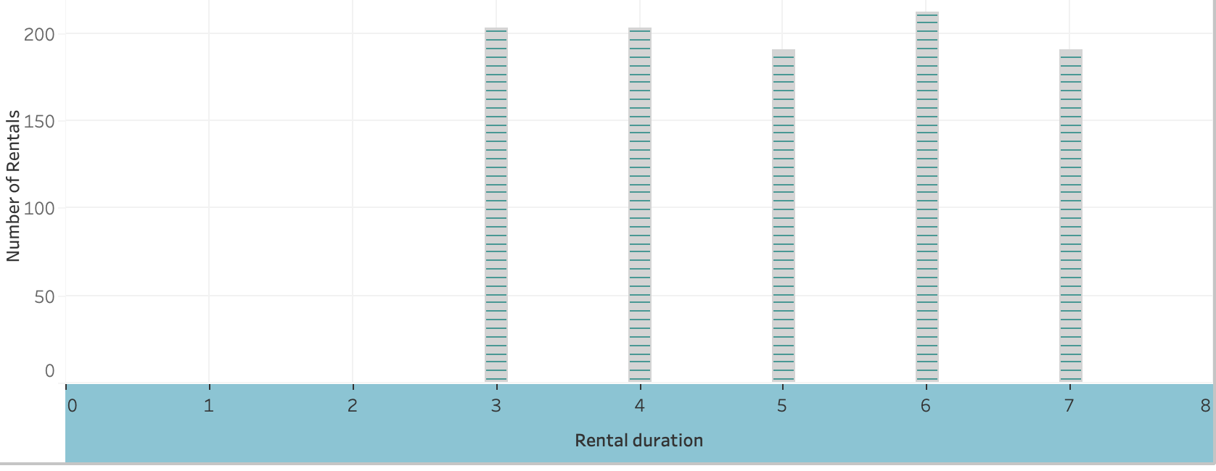
What was the average rental duration for all videos?
The Average rental duration was 5 days.
All the film rental duartions are between 3 to 7 days.
The most frequent rental duration was 6 days.

Slide 8
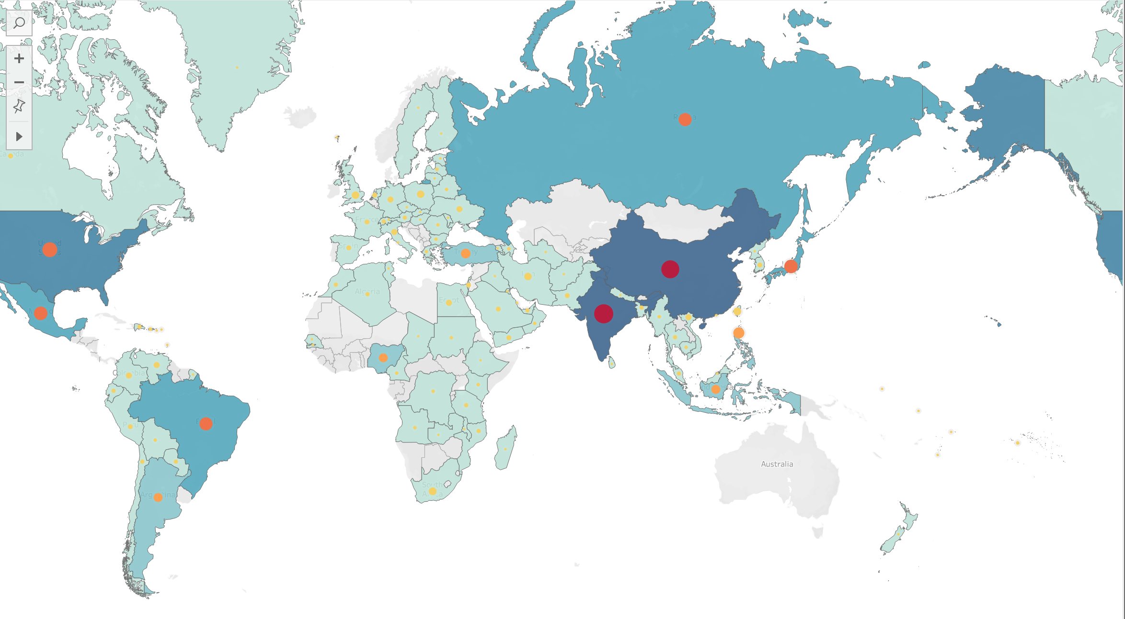
WHICH COUNTRIES ARE THE ROCKBUSTER CUSTOMERS BASED IN?
The Rockbuster customers are mostly based in India, followed by China.

Slide 9
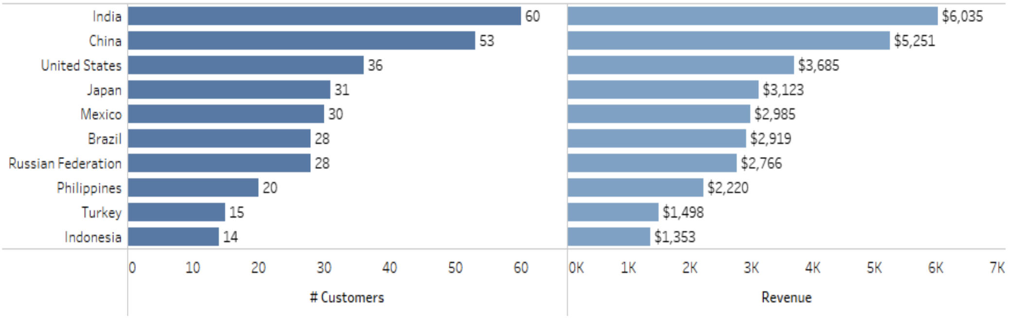
SALES IN DIFFERENT GEOGRAPHIC REGIONS
The Bar Graph shows that countries with the most customer based are contributing to the most amount of revenue.

Slide 10
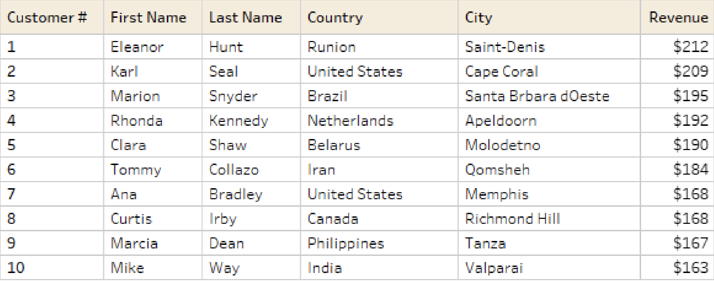
WHERE ARE THE CUSTOMERS WITH A HIGH LIFETIME VALUE BASED?

Slide 11
RECOMMENDATIONS
From the analysis made, India & China contributes to 18% amount of total revenue. But, rockbuster movies are available in english. Releasing the movies in the native languages in these countries may increase customer interest thus helps in incresing the revenue.
Rewarding the loyal customers: Offer loyalty programmes and bonus incentives for high value customers.
Incresing the promotional efforts and marketing resources in the top revenue generating countries like India, China, United States helps in bringing business and making revenue.
Perform a review on the lowest revenue generating countries and movies. Decide if they are worth investing in these countries and also decide on the genre of movies which are contributing least to the revenue.

Slide 12
THANK YOU
Any Queries?
Contact: kummari.srilatha@outlook.com
https://public.tableau.com/app/profile/srilatha.kummari/viz/RockbusterMovieRentalAnalysis_17192705507430/Top10Countries?publish=yes

